Slide 1

Fault Tolerant & Crash Consistency
Computer System Engineering, Fall 2019. (IPADS, SJTU)
Reliable System from Unreliable Components
Yubin Xia

Slide 2
File System: Durability != Consistency
Topic: tension between fs perf. and crash recovery
Disk performance is often a #1 bottleneck
"how many seeks will that take?"
Durability != Crash consistency
"Here is all of my data. But some of the metadata is wrong."
Crash recovery is much harder than performance
"what if a crash occurred at this point?"

Slide 3
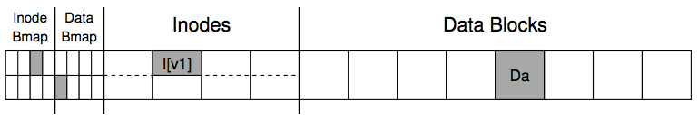
An Example: Append a File
Inside of I[v1]:
owner : yubin
permissions : read-only
size : 1
pointer : 4
pointer : null
pointer : null
pointer : null
Inside of I[v2]:
owner : yubin
permissions : read-only
size : 2
pointer : 4
pointer : 5
pointer : null
pointer : null

Slide 4
Crash Scenarios: 1 Succeeds
Imagine only a single write succeeds; there are thus three possible outcomes:
1. Just the data block (Db) is written to disk
What will happen?
2. Just the updated inode (I[v2]) is written to disk
What will happen?
3. Just the updated bitmap (B[v2]) is written to disk
What will happen?

Slide 5
Crash Scenarios: 2 Succeed
Two writes succeed and the last one fails:
1. The inode (I[v2]) and bitmap (B[v2]) are written to disk, but not data (Db)
2. The inode (I[v2]) and the data block (Db) are written, but not the bitmap (B[v2])
3. The bitmap (B[v2]) and data block (Db) are written, but not the inode (I[v2])
Notes:
Metadata is ok, but data is garbage
Metadata inconsistency!
Block leakage. No idea which inode the block belongs to.

Slide 6
Our Expectation
After rebooting and running recovery code
1. FS internal invariants maintained
E.g., no block is both in free list and in a file
2. All but last few operations preserved on disk
E.g., data I wrote yesterday are preserved
User might have to check last few operations
3. No order anomalies
$ echo 99 > result ; echo done > status

Slide 7
MTTF & Availability

Slide 8

MTTF, MTTR, MTBF
MTTF: mean time to failure
MTTR: mean time to repair
MTBF: mean time between failure
MTBF = MTTF + MTTR
TBF-1
TBF-2
TBF-3
TTR-1
TTF-1
TTR-2
TTF-2
TTR-3
TTF-3

Slide 9
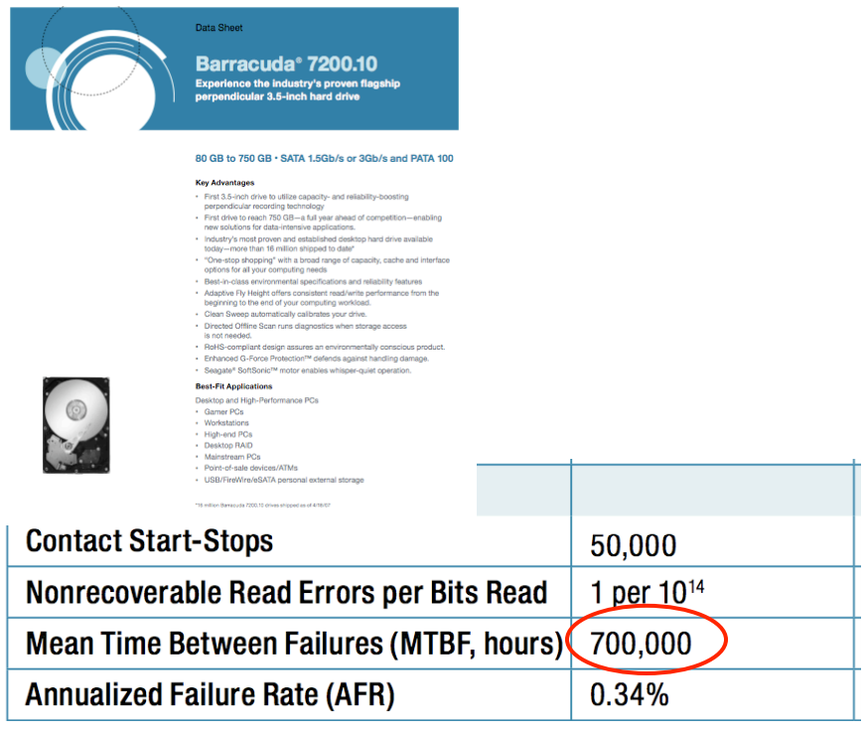
MTBF
Web page snapshot

Slide 10
Measuring MTBF
Two purposes: evaluating & predicting
The more reliable, the longer it takes to evaluate
Not measure directly, but use proxies to estimate its value
One way to measure "MTBF"
E.g. 3.5-inch disk's MTTF is 700,000 hours (80 years!)
Guess: ran 7,000 disks for 1,000 hours and 10 failed
If the failure process were memoryless, then OK
"expected operational lifetime" is only 5 years

Slide 11
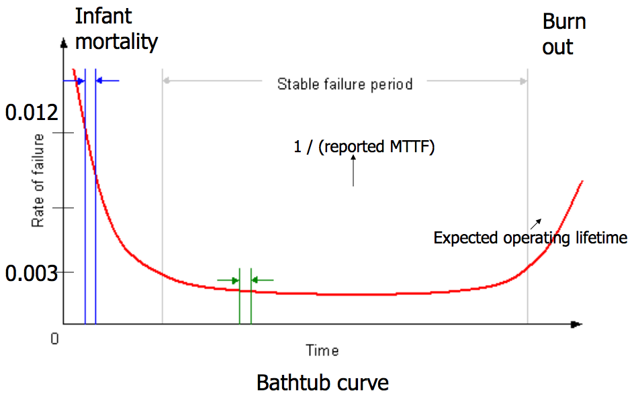
Bathtub Curve
gross manufacturing defects
run for a while before shipping
accumulated ware and tear cause failure

Slide 12
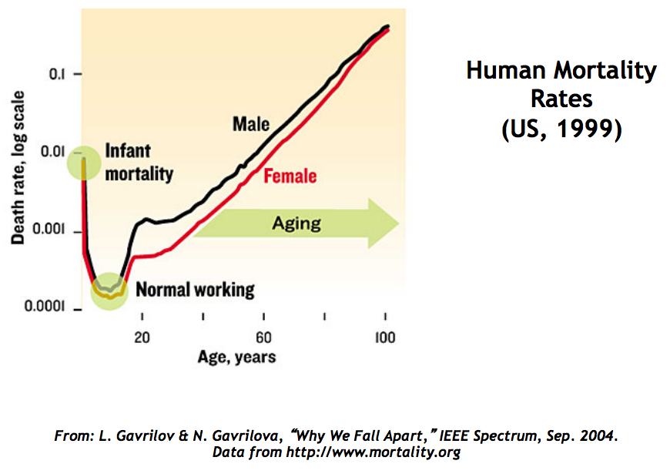

Slide 13
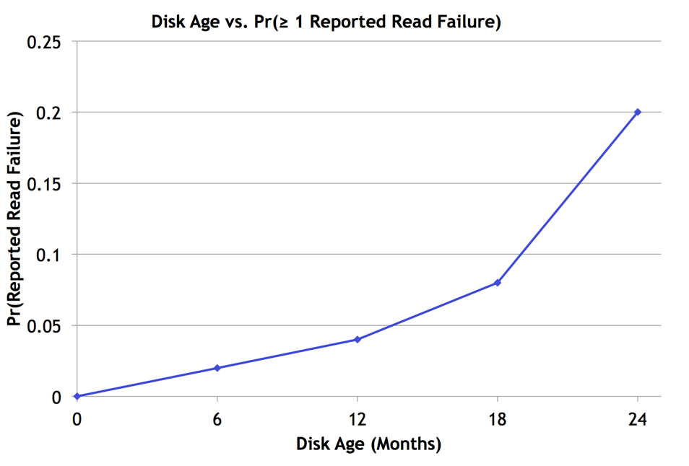
Bairavasundaram et al., SIGMETRICS 2007

Slide 14
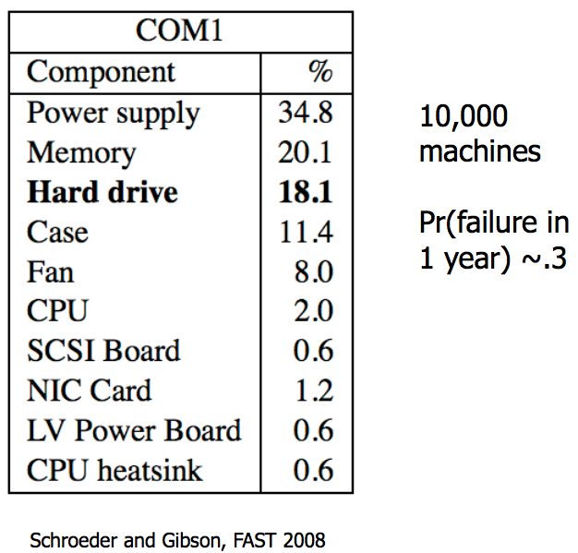
Frequency of Hardware Replacement

Slide 15
Availability
Counting the number of nines
E.g. 99.9% has 3-nines availability
Often used in marketing
Corresponding down time
E.g. 3-nines -> 8 hour/year
E.g. 5-nines -> 5 min/year
E.g. 7-nines -> 3 sec/year
Without any information about MTTF
More fine-grained
Fail-soft, as in 8.3

Slide 16
Availability in Practice
Carrier airlines (2002 FAA fact book)
99.9993% availability, 41 accidents, 6.7M departures
911 Phone service (1993 NRIC report)
99.994%, 29 minutes per line per year
Standard phone service (various sources)
99.99+%, 53+ minutes per line per year
End-to-end Internet Availability
95% - 99.6%

Slide 17
Redundancy

Slide 18
Systematically Applying Redundancy
Masking error
Analog system designer: margin
Digital system designer: redundancy
Outline
Coding: incremental redundancy
Replication: massive redundancy
Voting
Repair

Slide 19


Recall: Coding for Incremental Redundancy
Forward error correction
Perform coding before storing or transmitting
Later decode the data without appealing to the creator
Hamming distance
Number of 1 in A ⊕ B , ⊕ is exclusive OR (XOR)
If H-distance between every legitimate pair is 2
000101, can only detect 1-bit flip
If H-distance between every legitimate pair is 3
Can only correct 1 bit flip
If H-distance between every legitimate pair is 4
Can detect 2-bit flip, correct 1-bit flip

Slide 20
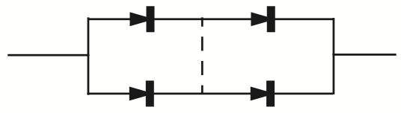
Replication: Massive Redundancy
Redundancy in bridge building
Material strength: 5 or 10 times as strong as min
Heavy-handed, but simple and effective
Replication
Replicas: identical multiple copies
E.g. Quad component by Shannon & Moore
Can tolerate single short circuit and single open circuit, and others
Mask failures silently

Slide 21

Voting
NMR: N-modular redundancy (supermodule)
E.g. TMR (3MR) and 5MR
Voter: compare the outputs with the same inputs
Can be applied at any level of module
Fail-vote: NMR with a majority voter
Raise an alert if any replicas disagree with majority
Signal a failure if no majority
Fail-fast only if any two replicas fail in different ways
If two replicas fail in same way, then not fail-fast

Slide 22

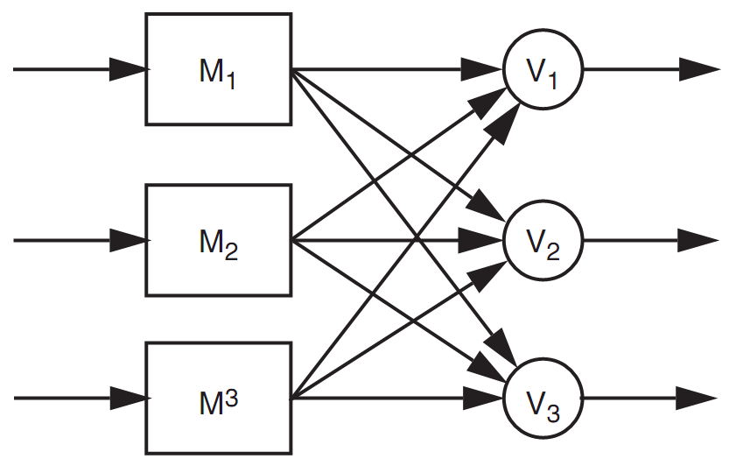
Voting
The probability that an incorrect result will be accepted by the voter is that it is no more than:
Assume the voter is perfectly reliable, which is not practical
Voter should also be replicated
Everything should be replicated
Recursive: voters belong to next module
Final voter should be the client

Slide 23
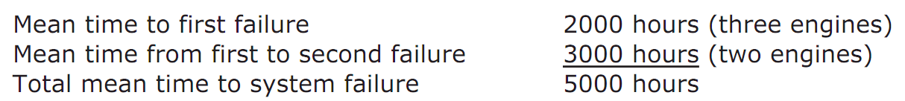
Voting
TMR can improve reliability
If R(T) = 0.999, TMR's R(T) = 0.999997
But MTTF can be smaller
If MTTF is 6,000 hours and fails independently, and the mechanism of engine failure is memoryless
6,000 hours in only 2,000 hours of flying, first fail
3,000 hours next and cause the second fail
5,000 hours < 6,000 hours

Slide 24
MTTF-replica and MTTF-system
If MTTF-replica = 1, N replicas total
Expected time until 1st failure is MTTF-replica/N
Expected time from then until the 2nd is MTTF-replica/(N-1)
Expected time until the system of N replicas fails is
For large N is approximately ln(N)
If mission time is long compared with MTTF-replica
Simple replication escalates the cost while providing little benefit

Slide 25
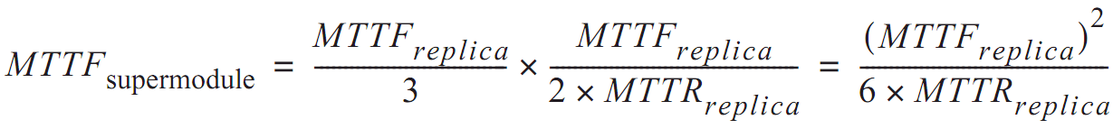
Repair
Return to fail-vote TMR supermodel
Requires at least two replicas be working
The rate of failure of 2 replicas is 2/MTTF
If replacement takes 1 hour, chance is 1/3000
Once replaced, expect to fly another 2000 hours until next engine failure
If we have unlimited replacement for 10,000 hours
MTTF = 6 million hours

Slide 26
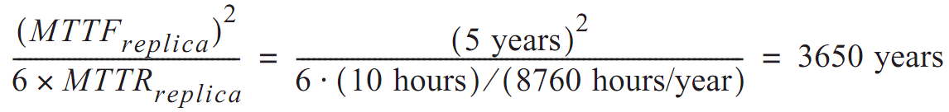
In another word
Although MTTF is reduced by the factor of 3
The availability of repair has increased MTTF by a factor equal to the ratio of the MTTF to MTTR of the remaining 2 engines
Disk with 3 replicas
If MTTF is 5-year, repair in 10 hours

Slide 27
Review Overly Optimistic Assumptions
Disks fail independently (?)
Same vendor, same fault
Earthquake, whose MTTF is less than 3650 years
Disk failures are memoryless (?)
Bathtub curve
Repair is also a memoryless process (?)
Stock enough spares
Repair is done flawlessly (?)
Replace the wrong disk, forget to copy data, etc.

Slide 28
Magnetic Disk Fault Tolerance

Slide 29
Magnetic Disk Fault Tolerance
Using disk as durable storage
Low cost, large capacity, non-volatility
Internal power can prevent data loss at power-off
Three/four nested layers
Raw storage, fail-fast storage, careful storage
Optional: durable storage

Slide 30
Magnetic Disk Fault Modes
Mechanical wear and tear
A bumping may cause a head to hit the surface
Head crush may also create cloud of dust
Results in several sectors decaying: decay set
Electronic components in the controller age
E.g. clock timing and signal detection circuits
Cause previously good data to become unreadable, or bad data to be written
Soft or hard errors
Seek error
Arm moves to a wrong track

Slide 31
ALL_OR_NOTHING_PUT
procedure ALMOST_ALL_OR_NOTHING_PUT (data, all_or_nothing_sector)
CAREFUL_PUT(data, all_or_nothing_sector.S1)
CAREFUL_PUT (data, all_or_nothing_sector.S2)
CAREFUL_PUT (data, all_or_nothing_sector.S3)
procedure ALL_OR_NOTHING_GET (reference date,all_or_nothing_sector)
CAREFUL_GET (data1, all_or_nothing_sector.S1)
CAREFUL_GET (data2, all_or_nothing_sector.S2)
CAREFUL_GET (data3, all_or_nothing_sector.S3)
if (data1 = data2) data ← data1
else data ← data3
Notes:
Why "Almost"?
- Not repair previous damage

Slide 32
ALL_OR_NOTHING_PUT
procedure ALL_OR_NOTHING_PUT (data, all_or_nothing_sector)
CHECK_AND_REPAIR (all_or_nothing_sector)
ALMOST_ALL_OR_NOTHING_PUT (data, all_or_nothing_sector)
procedure CHECK_AND_REPAIR (all_or_nothing_sector) // Ensure copies match
CAREFUL_GET (data1, all_or_nothing_sector.S1)
CAREFUL_GET (data2, all_or_nothing_sector.S2)
CAREFUL_GET (data3, all_or_nothing_sector.S3)

Slide 33
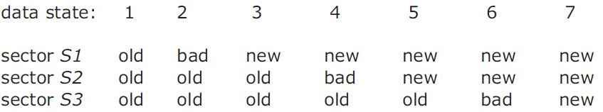
ALL_OR_NOTHING_PUT
if (data1 = data2) and (data2 = data3) return // State 1 or 7, no repair
if (data1 = data2)
CAREFUL_PUT (data1, all_or_nothing_sector.S3) return // State 5 or 6.
if (data2 = data3)
CAREFUL_PUT (data2, all_or_nothing_sector.S1) return // State 2 or 3.
CAREFUL_PUT (data1, all_or_nothing_sector.S2) // State 4, go to state 5
CAREFUL_PUT (data1, all_or_nothing_sector.S3 // State 5, go to state 7
Notes:
The choice of which to use is arbitrary; as shown the procedure copies the new value in sector S1 to both sectors S2 and S3.

Slide 34

Durable Storage: RAID 1
Tolerate error
Hard errors reported by careful layer are masked by reading from other replicas
Untolerated error
Decay on the same sector of all the replicas, status = BAD
OS crashes during a DURABLE_PUT
Decay in a way that is undetectable
Redundant Array of
Independent Disks

Slide 35
Improving on RAID-1
Clerk: periodically checks for decays
T_{d} as the period, must short enough
Tolerated error
Hard errors reported by careful layer are masked by reading from one of the other replicas
Data of a single decay set decays, is discovered by the clerk, and is repaired, all within T_{d} of the decay event
Untolerated error
The OS crashes during DURABLE_PUT
All decay sets fail with T_{d}
The data of some sector decays in a way undetectable

Slide 36
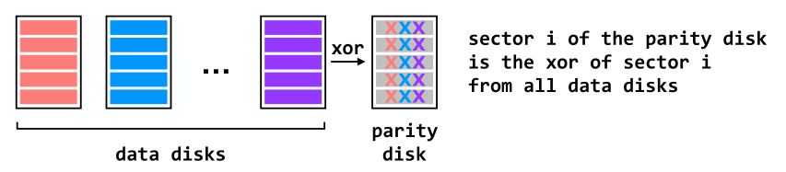
RAID 4 (Dedicated Parity Disk)
Can recover from single-disk failure
Requires N+1 disks (not 2N)
Performance benefits if stripe a single file across multiple data disks
- All writes hit the parity disk

Slide 37
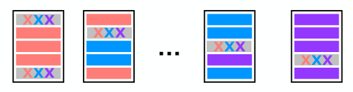
RAID 5 (Spread Out the Parity)
Can recover from single-disk failure
Requires N+1 disks (not 2N)
Better performance if stripe a single file across multiple data disks
Writes are spread across disks

Slide 38
Question
Q: Can RAID solve the crash consistency problem in the beginning of this lecture?
No. There is a semantic gap between block layer and file layer: block layer cannot tell metadata and data

Slide 39
Recovering FS Metadata from Crash
1. Synchronous meta-data update + fsck
During check, synchronize metadata, such as file size
2. Soft update (FreeBSD fs modified on FFS)
not covered in this course
3. Logging (ext 3/4), xv6-rev6 and following versions
Before doing actual meta-data update, log the event
After crash, recover from log

Slide 40
Sync Metadata Update + fsck

Slide 41
Typical Set of Tradeoffs
FS ensures it can recover its meta-data
Internal consistency
No dangling references
Inode and block free list contain only used (not using) items
Unique name in one directory, etc.
Weak semantic FS provided limited guarantees
Atomicity for creat, rename, delete
Often no durability for anything
(creat("a"), then crash, no a)
Often no order guarantees

Slide 42
What does fsck do?
1. Check superblock
E.g., making sure the file system size is greater than the number of blocks allocated
If error, use an alternate copy of the superblock
2. Check free blocks
Scans the inodes, indirect blocks, double indirect blocks, etc.
Uses this knowledge to produce a correct version of the allocation bitmaps
Same for the inode bitmap

Slide 43
What does fsck do?
3. Check inode states
Check type: regular file, dir, symbolic link, etc.
Clear suspect inodes and clear the inode bitmap
4. Check inode links
Check link count by scanning the entire fs tree
If count mismatches, fix the inode
If inode is allocated but no dir contains it, lost+found
5. Check duplicates
Two inodes refer to the same block
If one inode is obviously bad, clear it; otherwise, copy the block and give each a copy

Slide 44
What does fsck do?
6. Check bad blocks
E.g., point to some out-of-range address
What should fsck do? Just remove the pointer
7. Check directories
The only file that fsck know more semantic
Making sure that "." and ".." are the first entries
Ensure no dir is linked more than once
No same filename in one dir

Slide 45

Problem of fsck: Too Slow
How long would fsck take?
an example server: fsck takes 10 minutes per 70GB disk w/ 2 million inodes
clearly reading many inodes sequentially, not seeking
still a long time, probably linear in disk size
Consider the example before:
Scan the disk for only three disk block writes
Just like find a key by searching the entire house

Slide 46
What's the right order of synchronous writes?
File creation
1. mark inode as allocated
2. create directory entry
File deletion
1. erase directory entry
2. erase inode addrs[], mark as free
3. mark blocks free

Slide 47
What about app-visible syscall semantics?
Durable? Yes
Use write-through cache, sync I/O, O_SYNC
Atomic? Often
Mkdir is an exception
Ordered? Yes
If all writes are sync

Slide 48
Issues with Synchronous Write
Main issue
Very slow during normal operation
Very slow during recovery

Slide 49
Ordinary perf. of sync meta-data update?
Creating a file and writing a few bytes
Takes 8 writes, probably 80 ms
(ialloc, init inode, write dirent, alloc data block, add to inode, write data, set length in inode, xxx)
Can create only about a dozen small files per second!
Think about un-tar or rm *

Slide 50
How to get better performance?
Reality:
RAM is cheap
Disk sequential throughput is high, 50 MB/sec
Why not use a big write-back disk cache?
No sync meta-data update operations
Only modify in-memory disk cache (no disk write)
So creat(), unlink(), write() &c return almost immediately
If cache is full, write LRU dirty block
Write all dirty blocks every 30 seconds, to limit loss if crash
This is how old Linux EXT2 file system worked

Slide 51
Write-back Cache
Would write-back cache improve performance?
Why performance would be improved?
After all, you have to write the disk in the end anyway
Notes:
Write absorbtion

Slide 52
What can go wrong with write-back cache?
E.g.: unlink() followed by create() an existing file x with some content, all safely on disk
One user runs unlink(x)
1. delete x's dir entry **
2. put blocks in free bitmap
3. mark x's inode free; another user then runs create(y)
4. allocate a free inode
5. initialize the inode to be in-use and zero-length
6. create y's directory entry **
again, all writes initially just to disk buffer cache
suppose only ** writes forced to disk, then crash
What is the problem? Can fsck detect and fix this?
Notes:
Problem: no mechanism to make unlink(), create(), &c atomic with respect to crashes and (unlike sync metadata update) no ordering hints for fsck

Slide 53
Barrier: Flush the Disk
Disk's write buffer
Disk will inform the OS the write is complete when it simply has been placed in the disk's memory cache
But the data is not on disk yet! No durability! No order!
One solution: disable the buffer
Another solution: using flush operation
Force the disk to write data to disk media
Aka., disk write barrier
However, disks may not do as they claim…
Some disks just ignore the flush operation to be faster
"the fast almost always beats out the slow, even if it is wrong" --- Kahan

Slide 54
Logging / Journaling

Slide 55
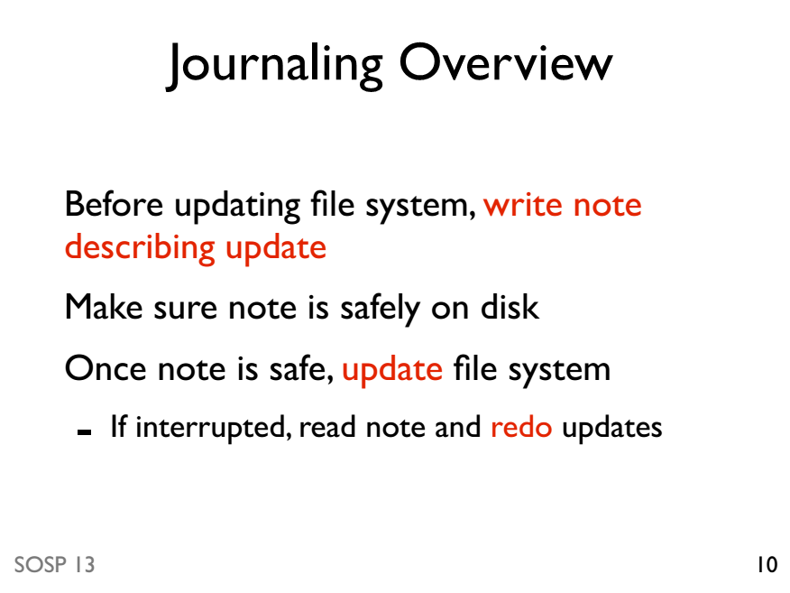

Slide 56
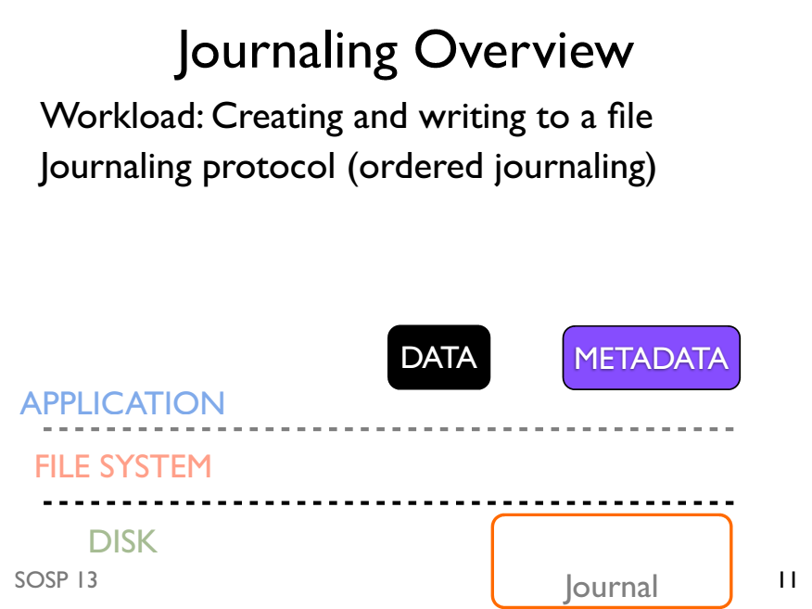

Slide 57
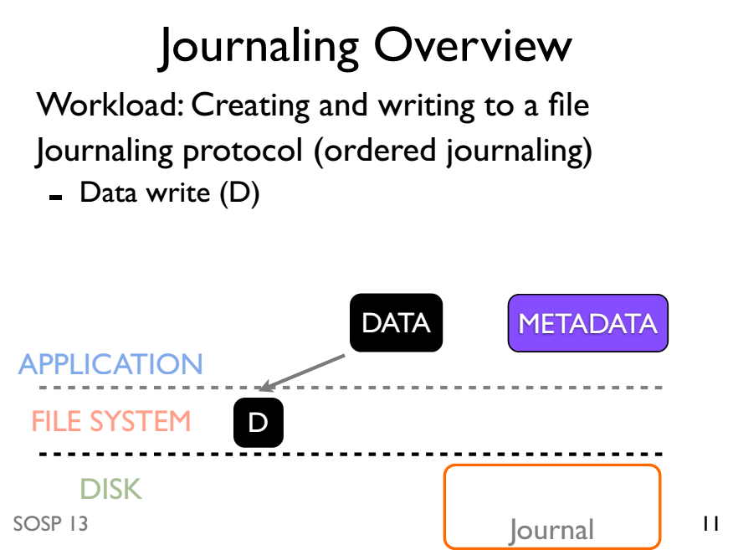

Slide 58
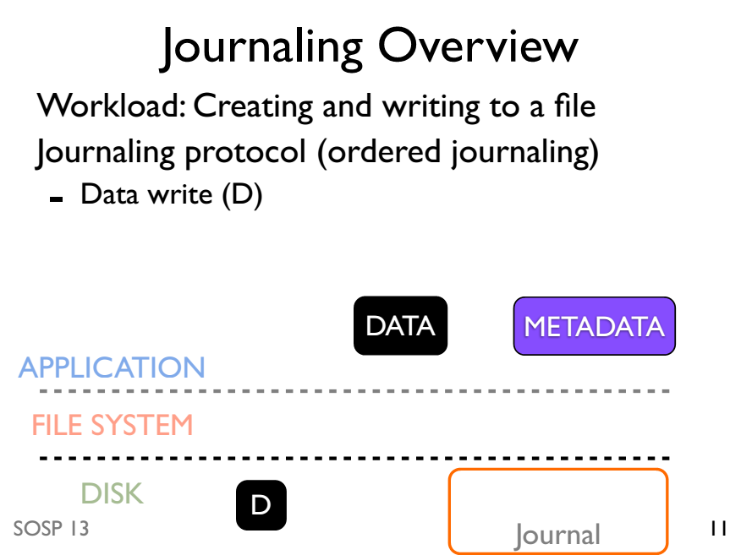

Slide 59
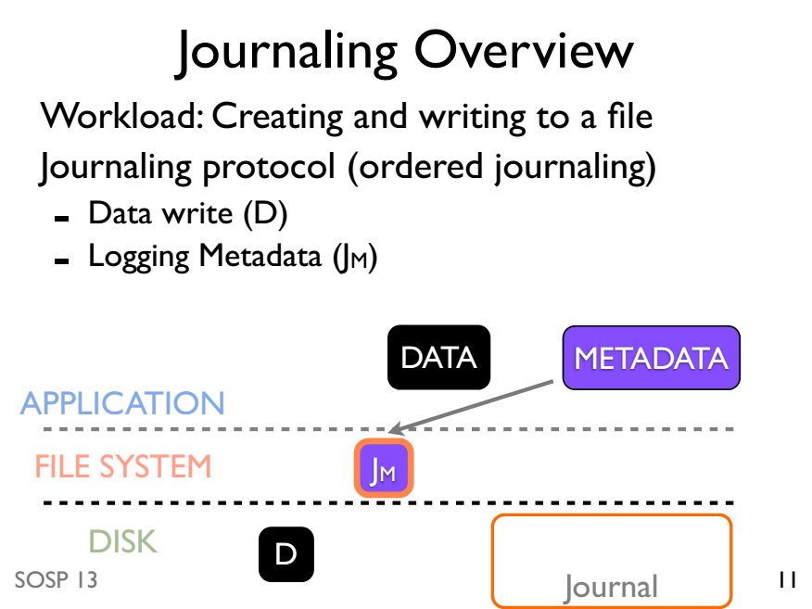

Slide 60
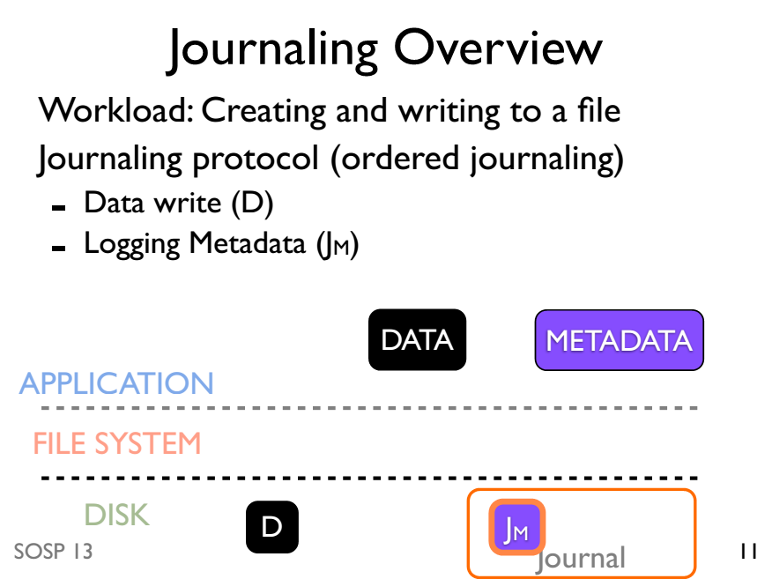

Slide 61
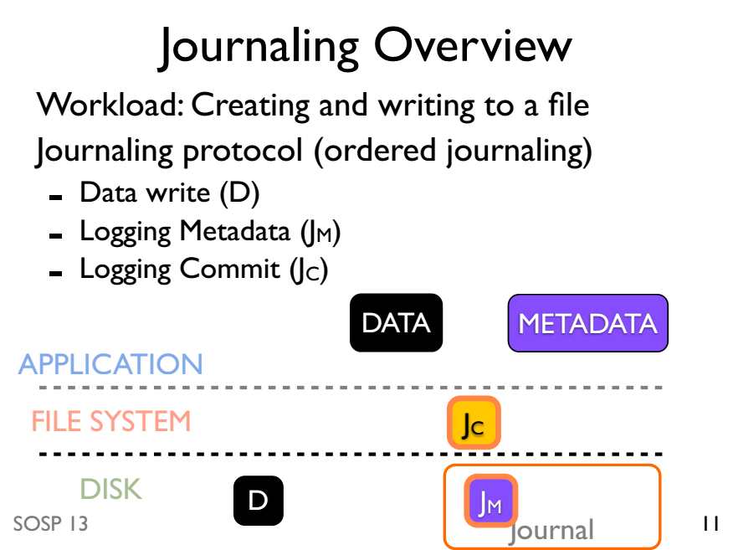

Slide 62
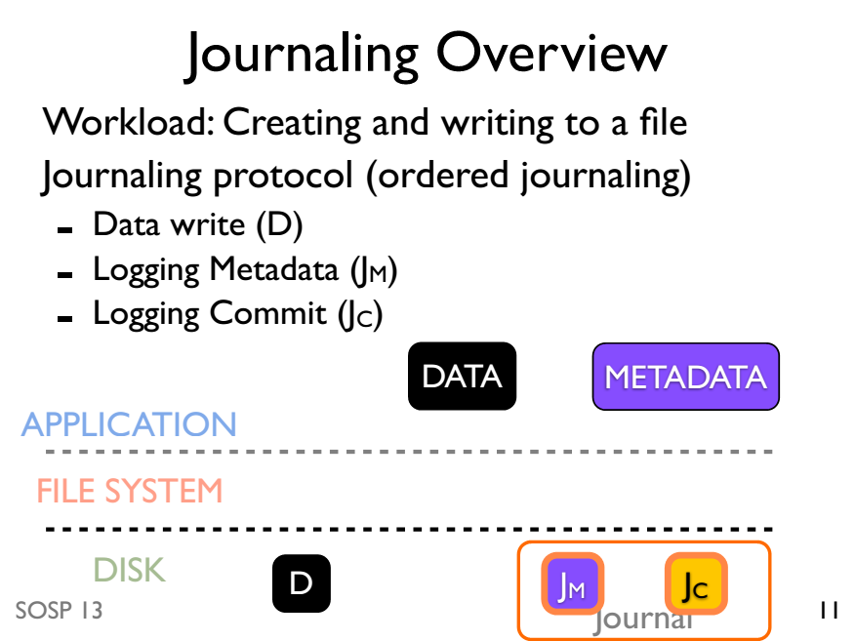

Slide 63
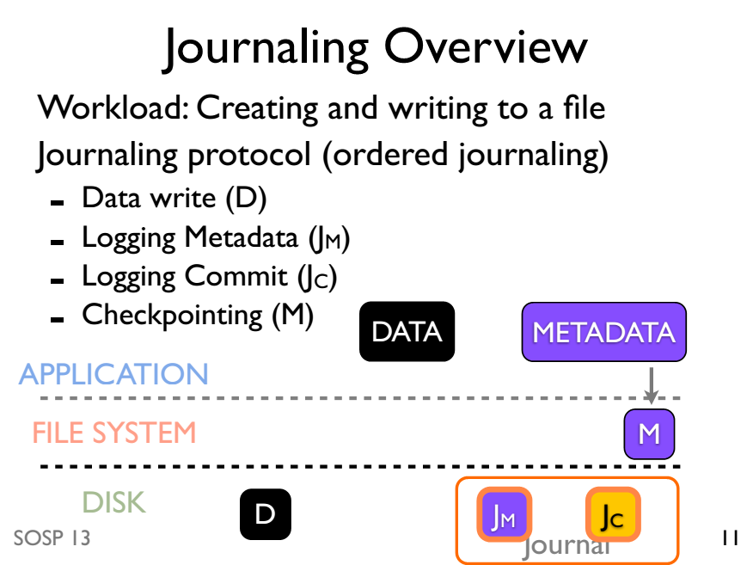

Slide 64
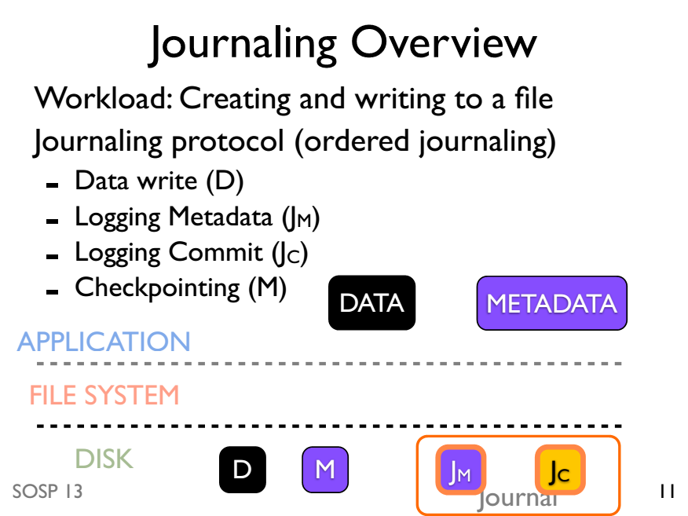

Slide 65
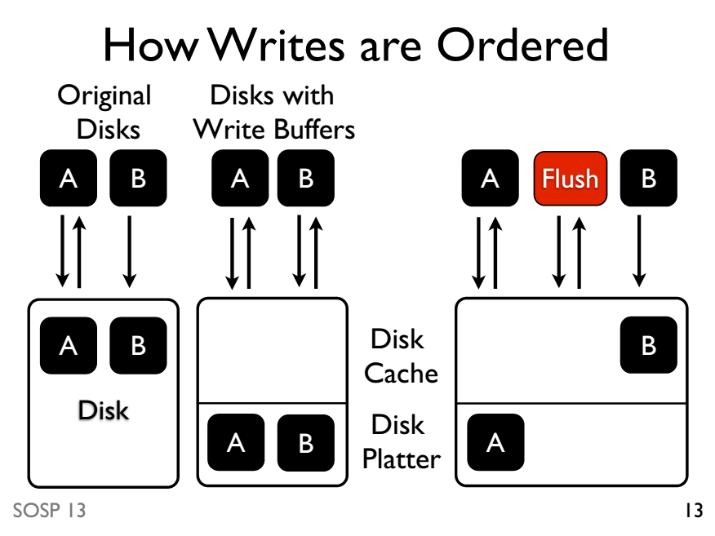

Slide 66
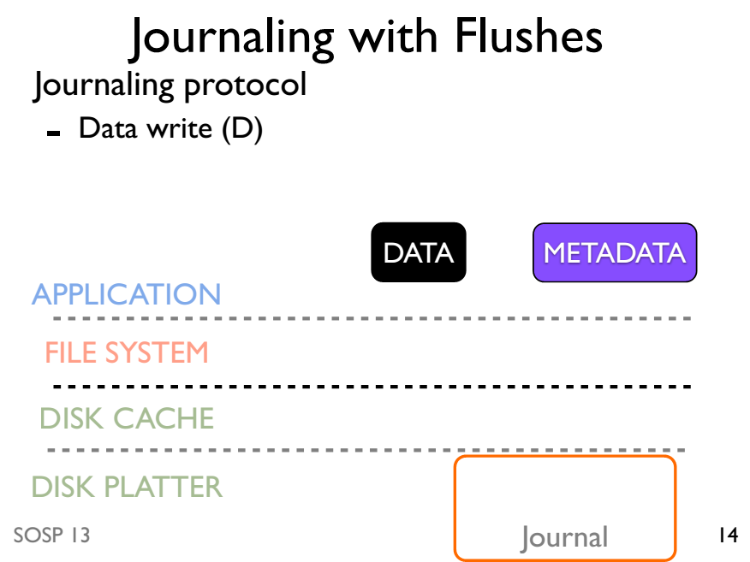

Slide 67
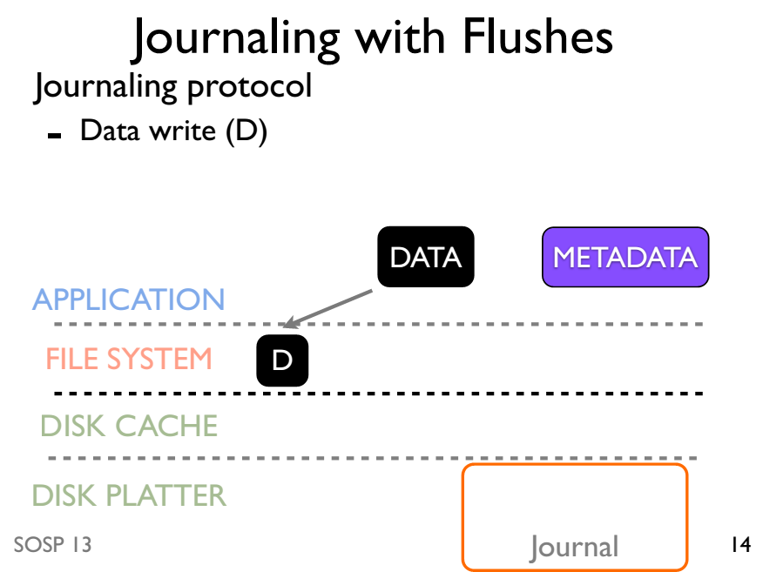

Slide 68
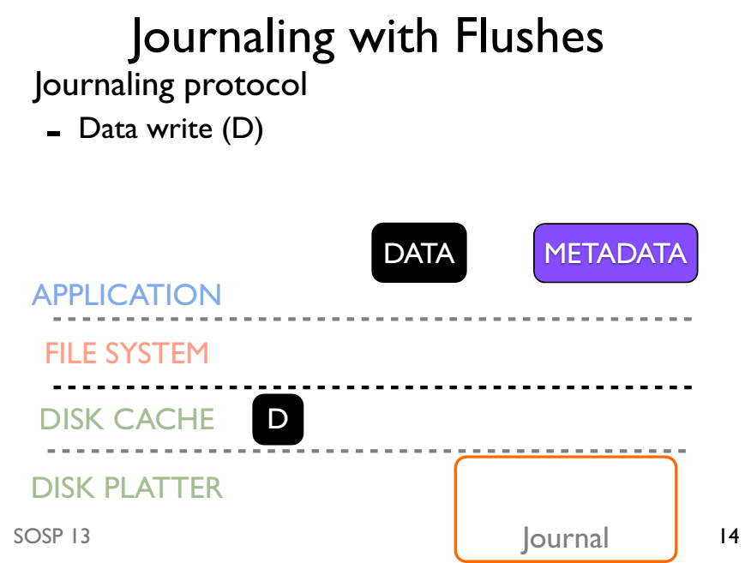

Slide 69
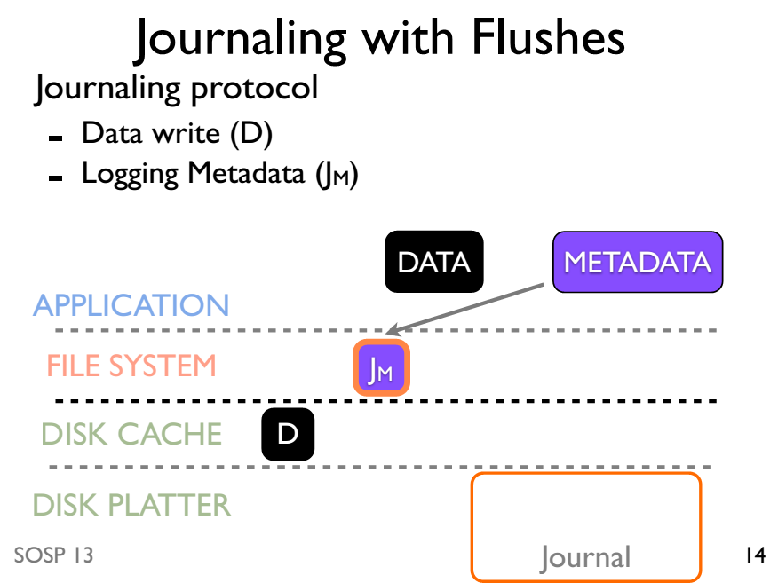

Slide 70
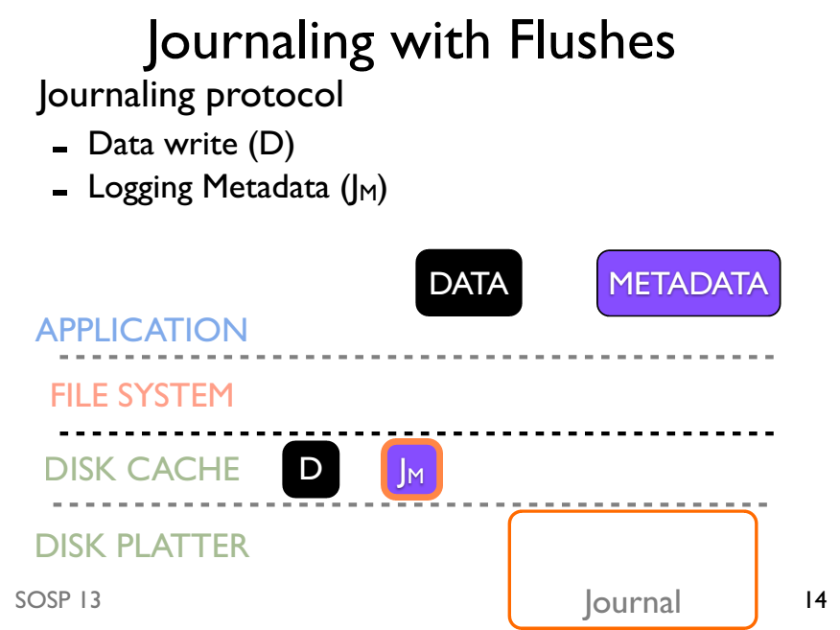

Slide 71
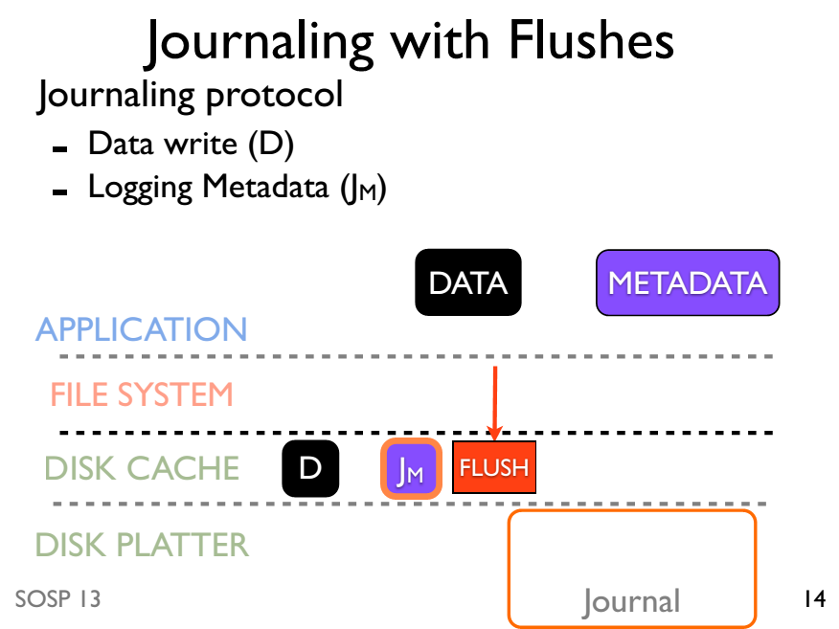

Slide 72
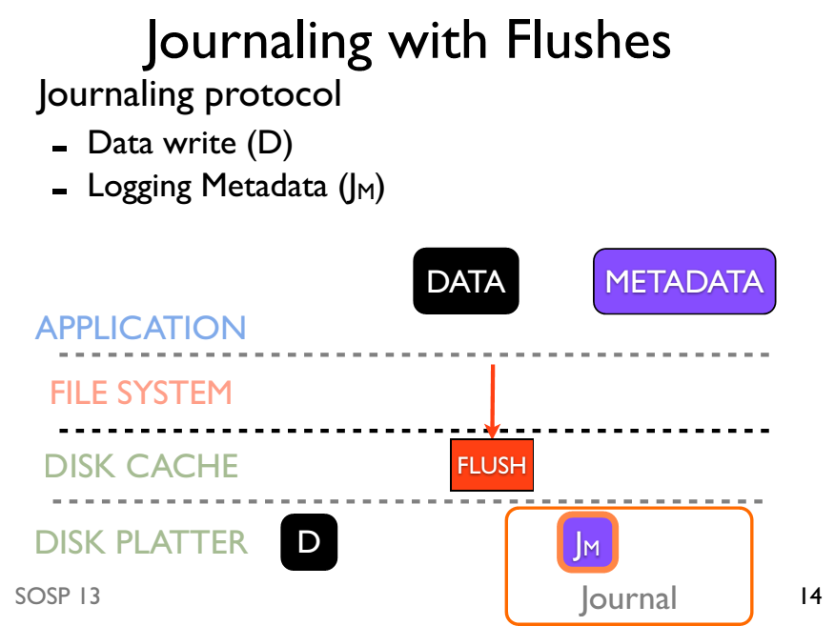

Slide 73
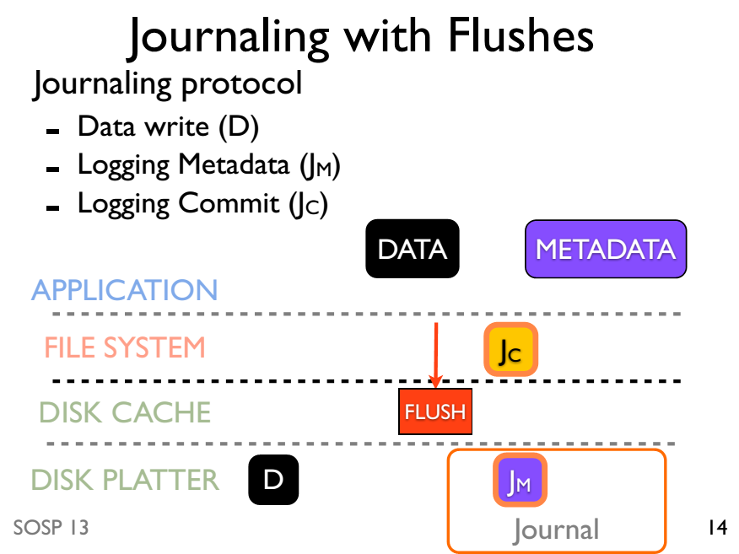

Slide 74
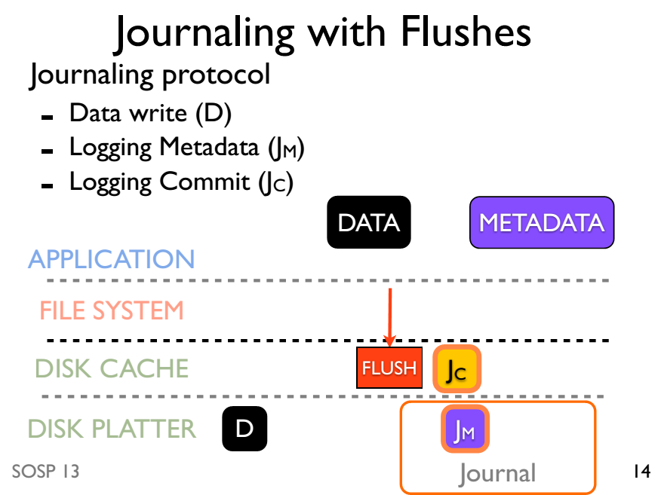

Slide 75
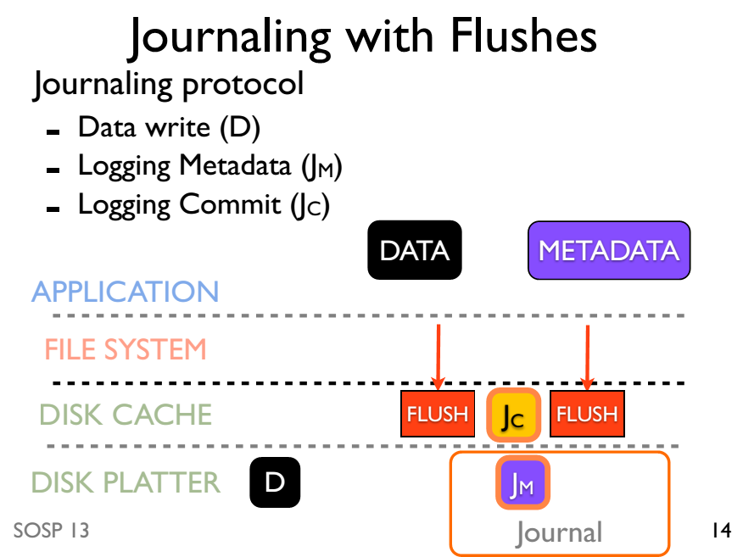

Slide 76
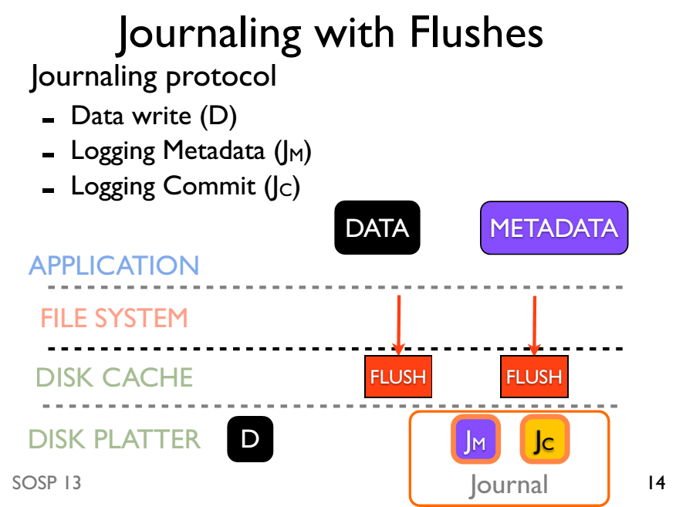

Slide 77
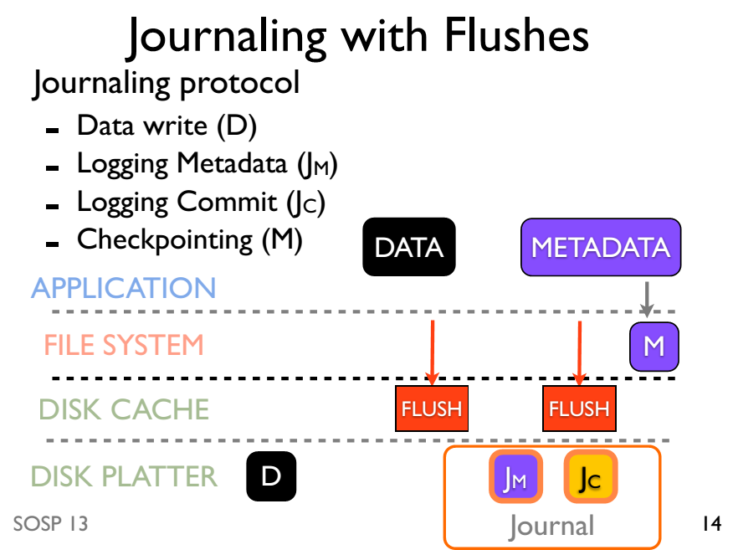

Slide 78
Journaling without ordering

Slide 79
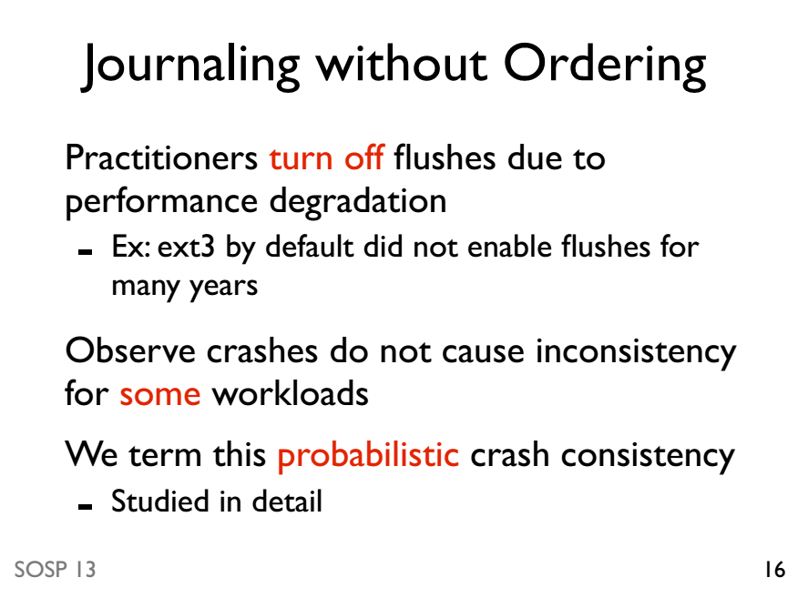

Slide 80
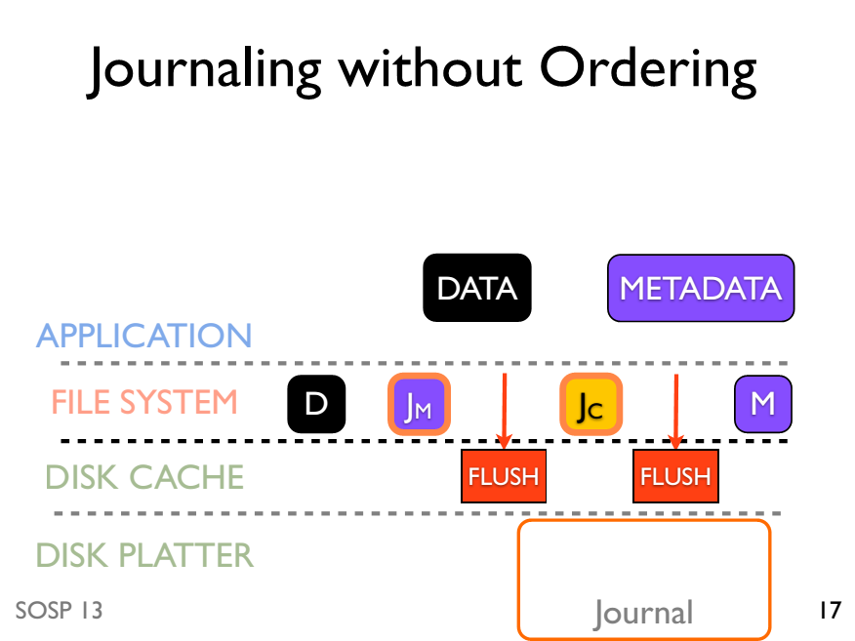

Slide 81
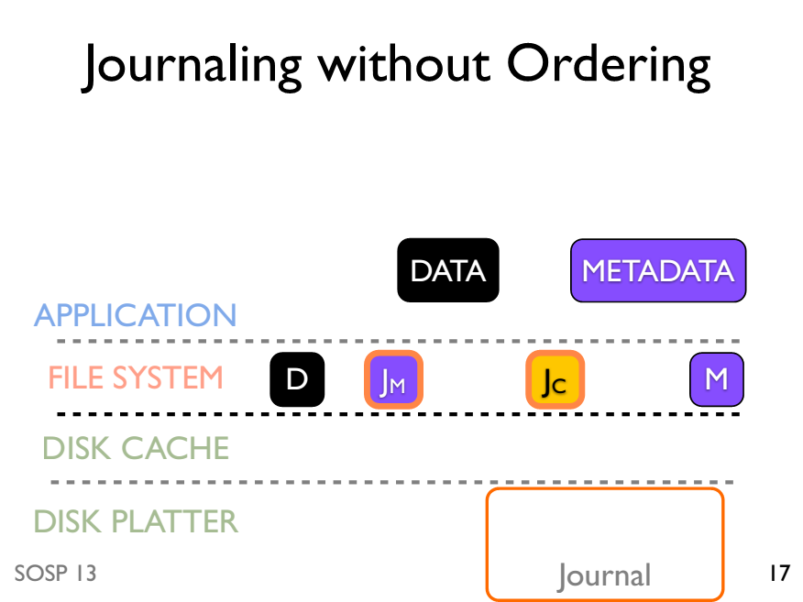

Slide 82
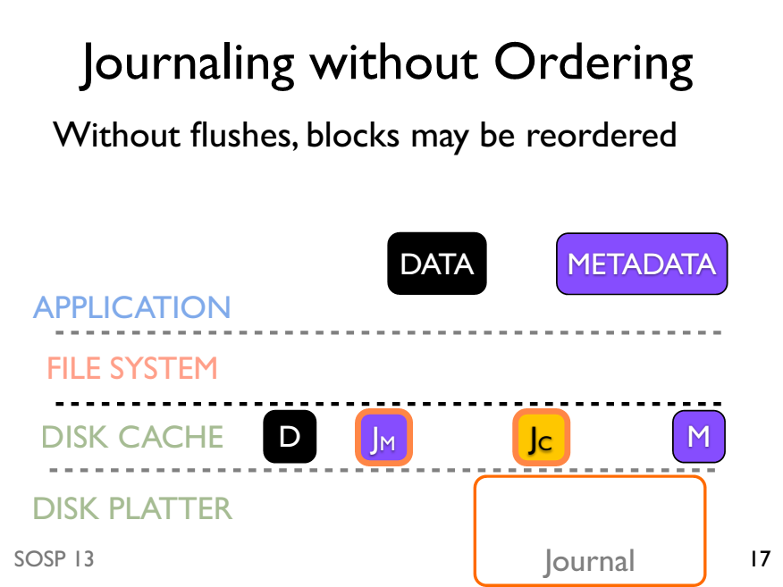

Slide 83
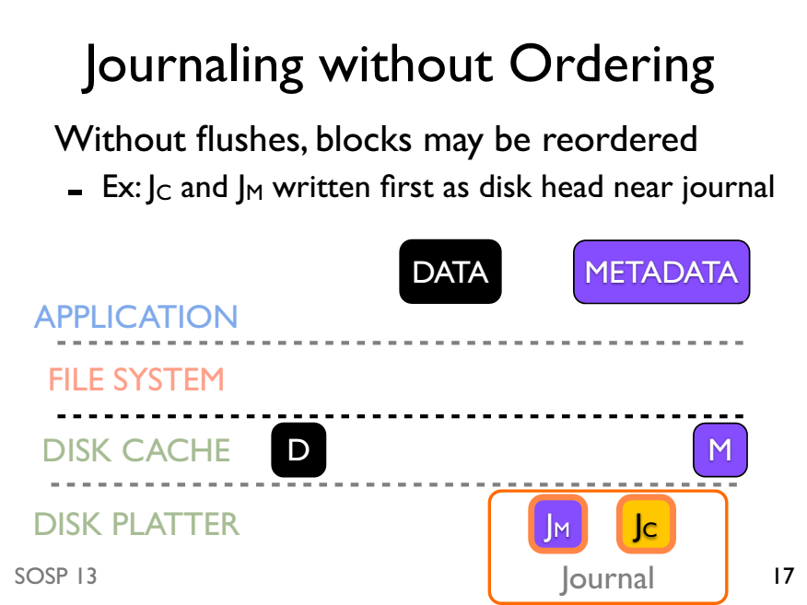

Slide 84
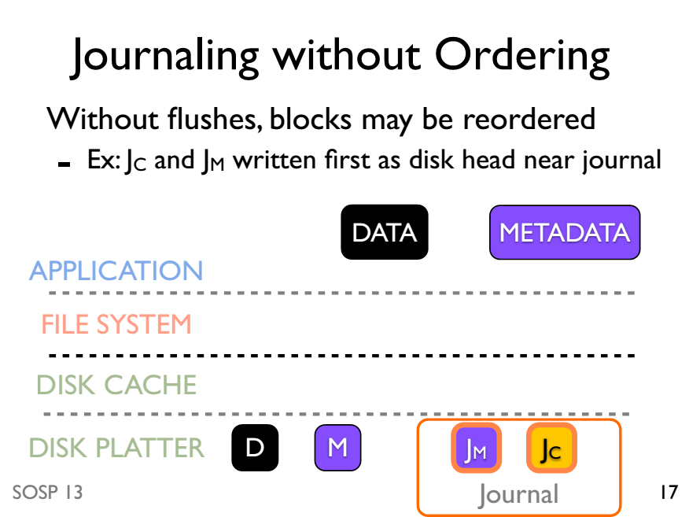

Slide 85
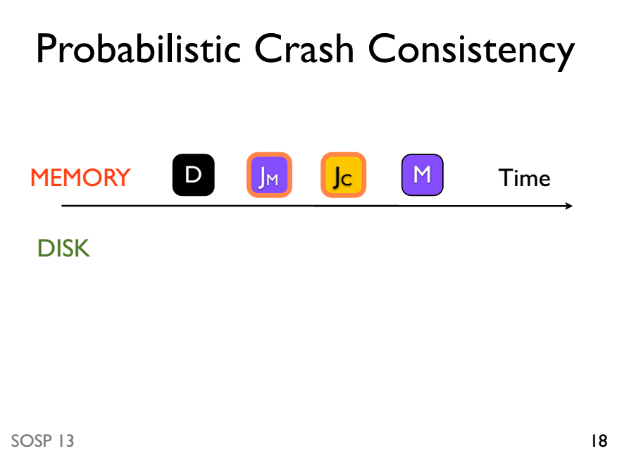

Slide 86
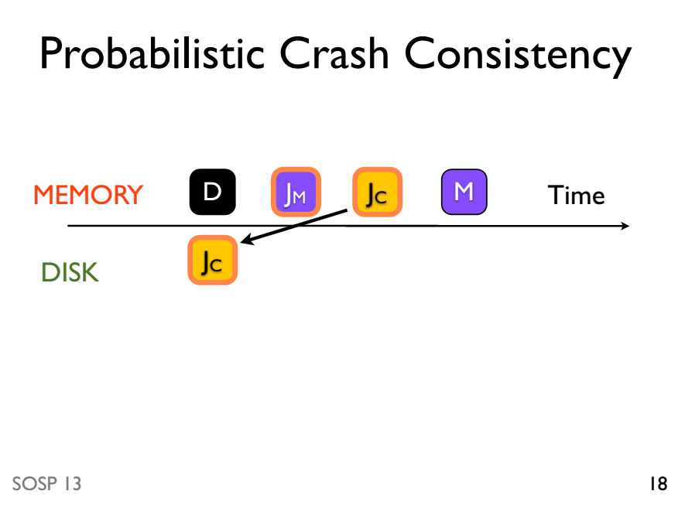

Slide 87
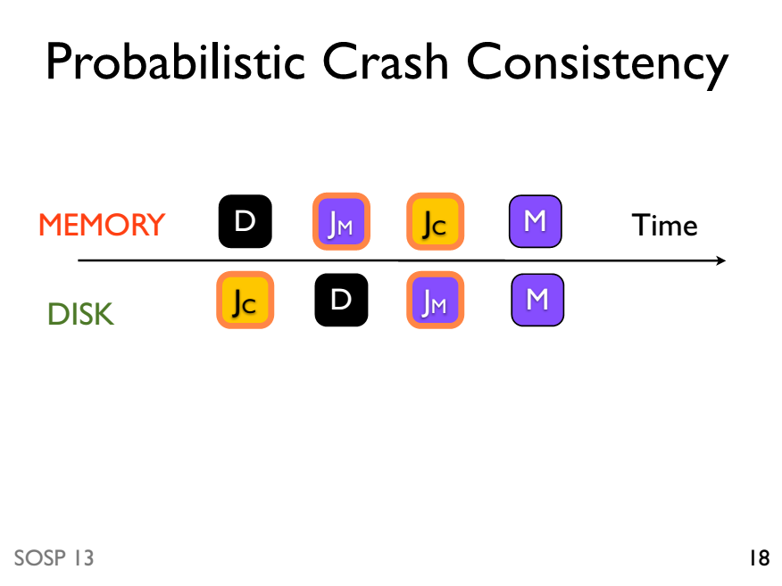

Slide 88
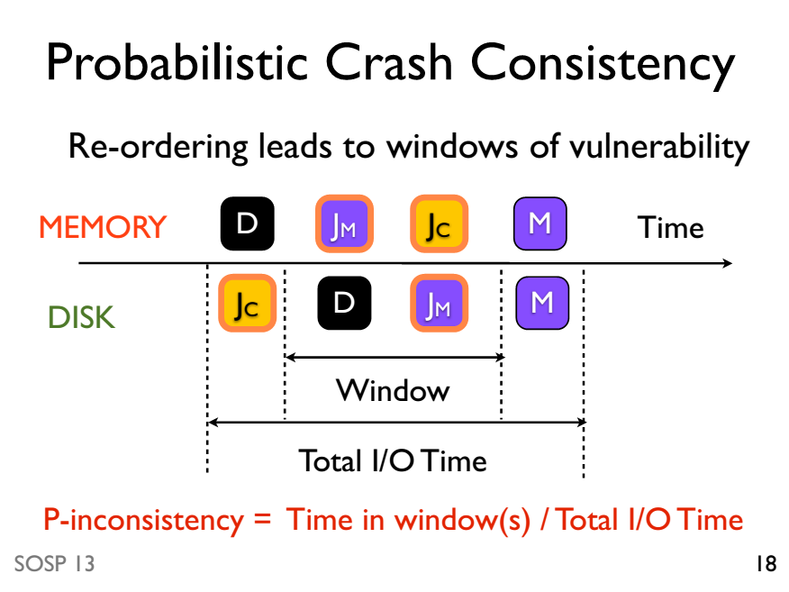

Slide 89
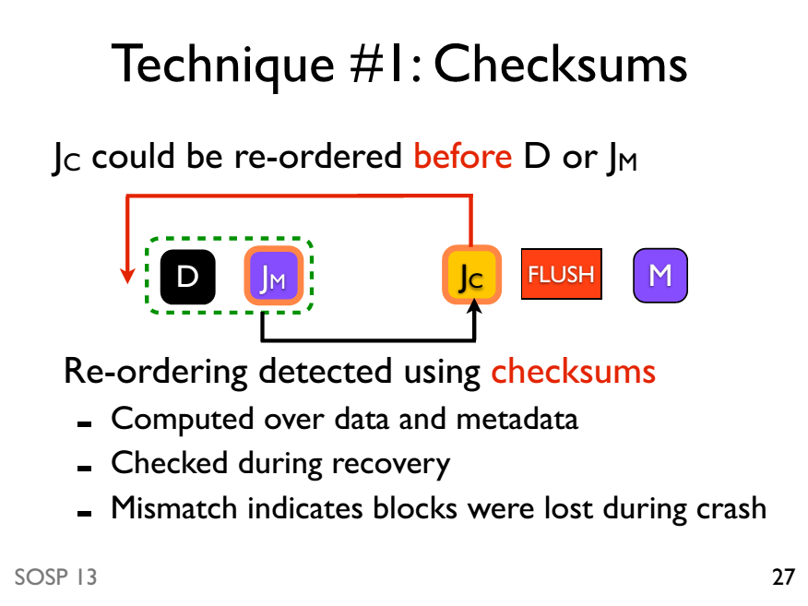

Slide 90
